Slide 1
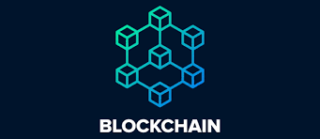

Slide 2
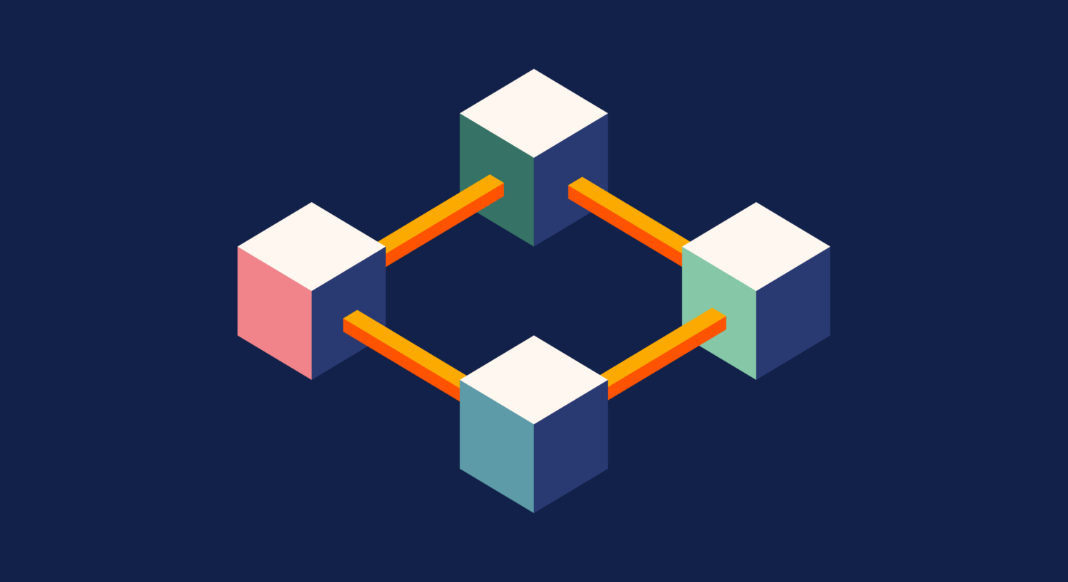
INTRODUCTION Blockchain

Slide 3
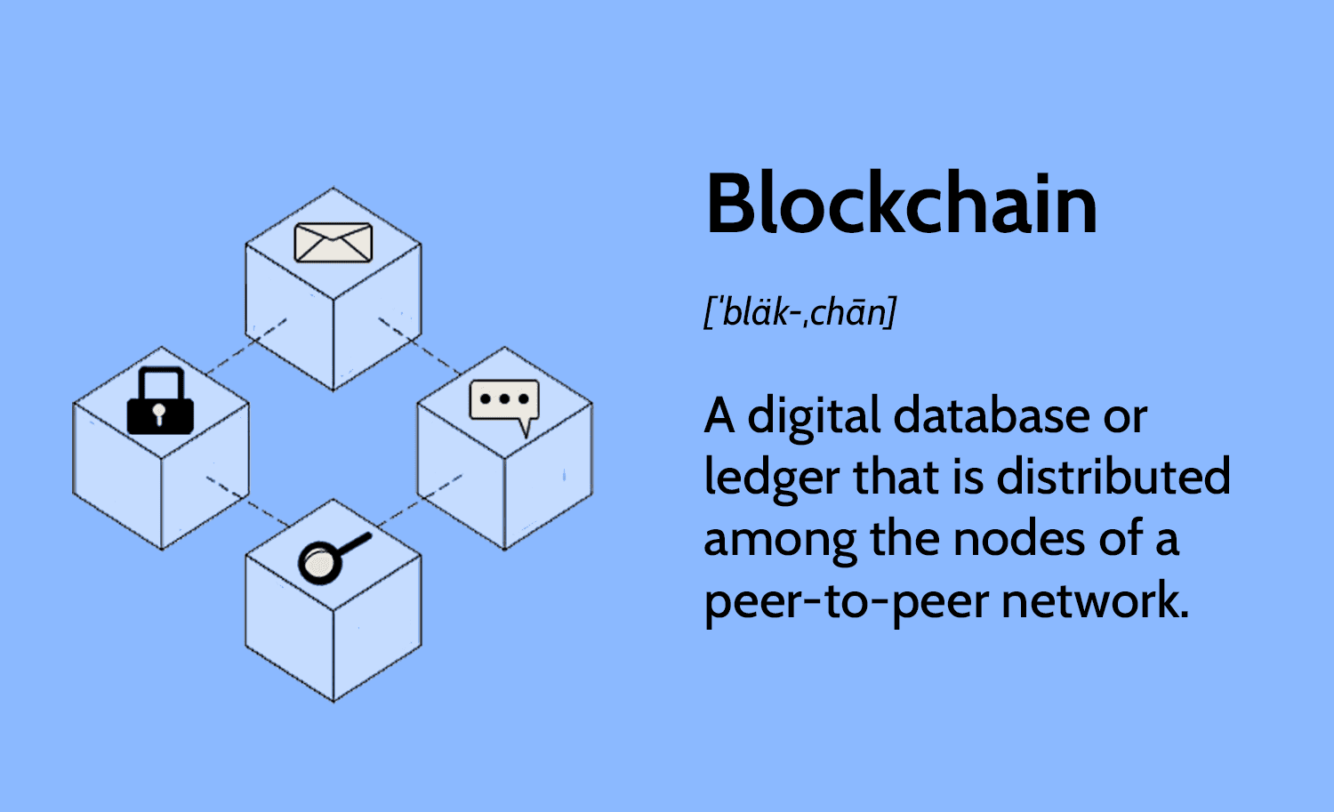

Slide 4
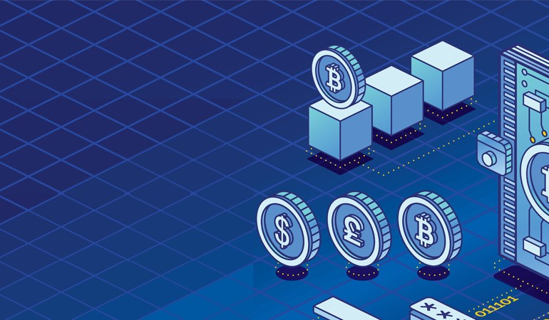
Blockchain is a distributed ledger
technology that enables
the secure and transparent recording
of transactions across a
network of computers.
In this system,data is stored in blocks,
each containing a collection of transactions.

Slide 5
These blocks are linked chronologically in
a chain through cryptographic hashes,
ensuring the integrity and immutability
of the recorded information.
This decentralized structure eliminates
the need for a central authority, allowing
participants to verify and audit transactions independently.

Slide 6
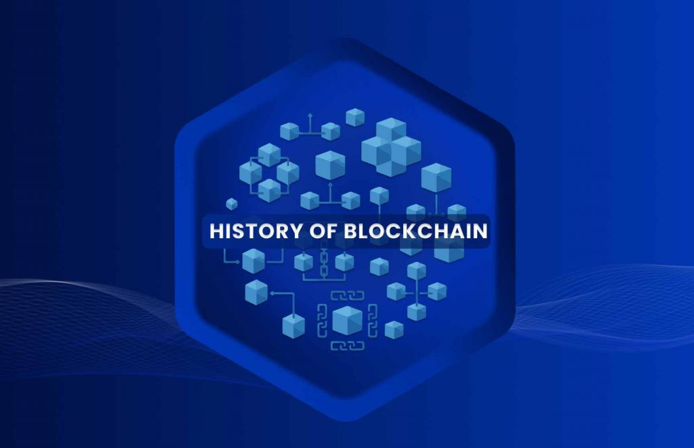

Slide 7
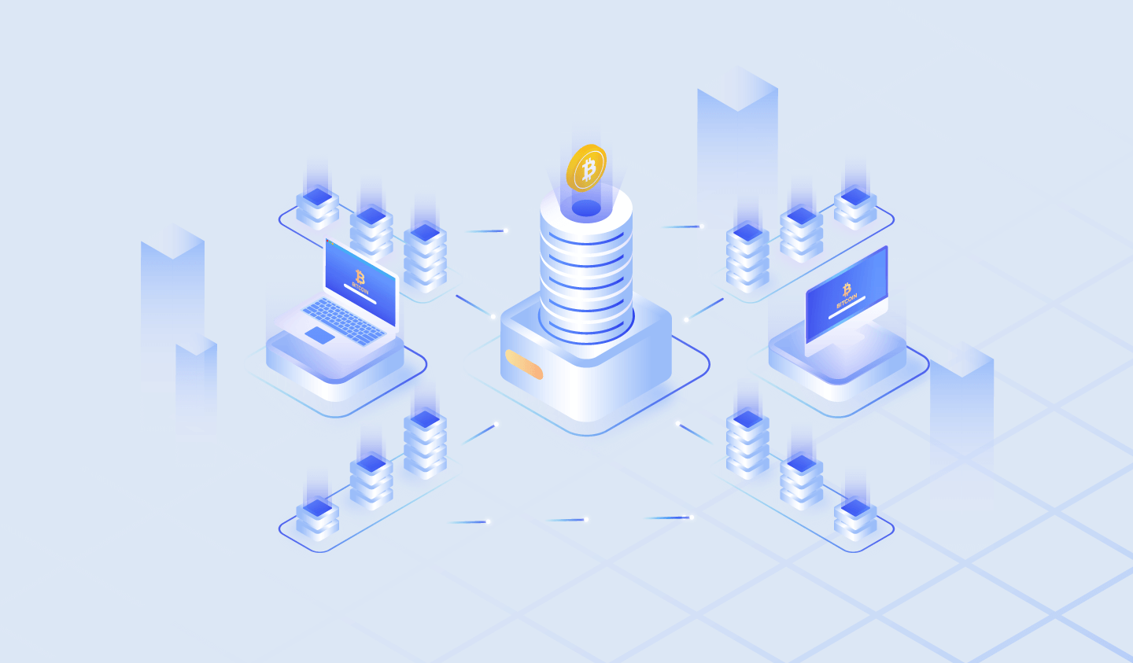
The conceptual foundation of blockchain dates back to 1991
when researchers Stuart Haber and W. Scott Stornetta introduced a computational solution
for time-stamping digital documents to prevent backdating or tampering. In 1992, they incorporated
Merkle trees into their design, enhancing efficiency by allowing multiple documents to be grouped within a single block.

Slide 8
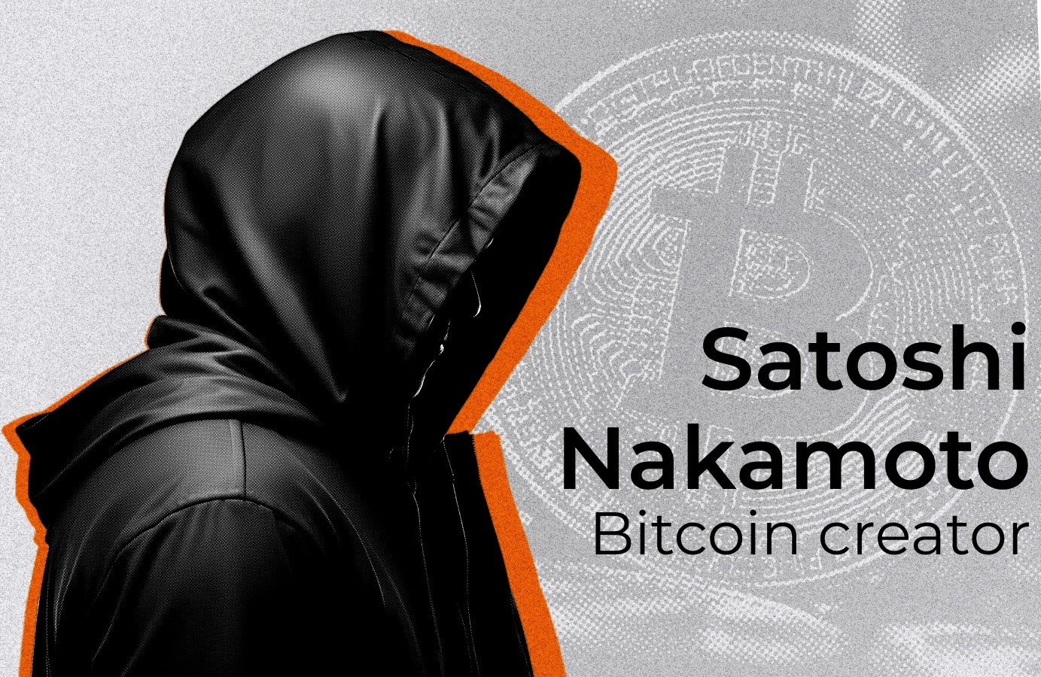

Slide 9
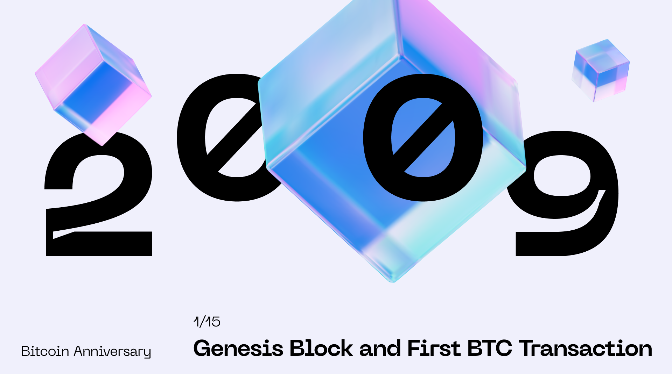

Slide 10
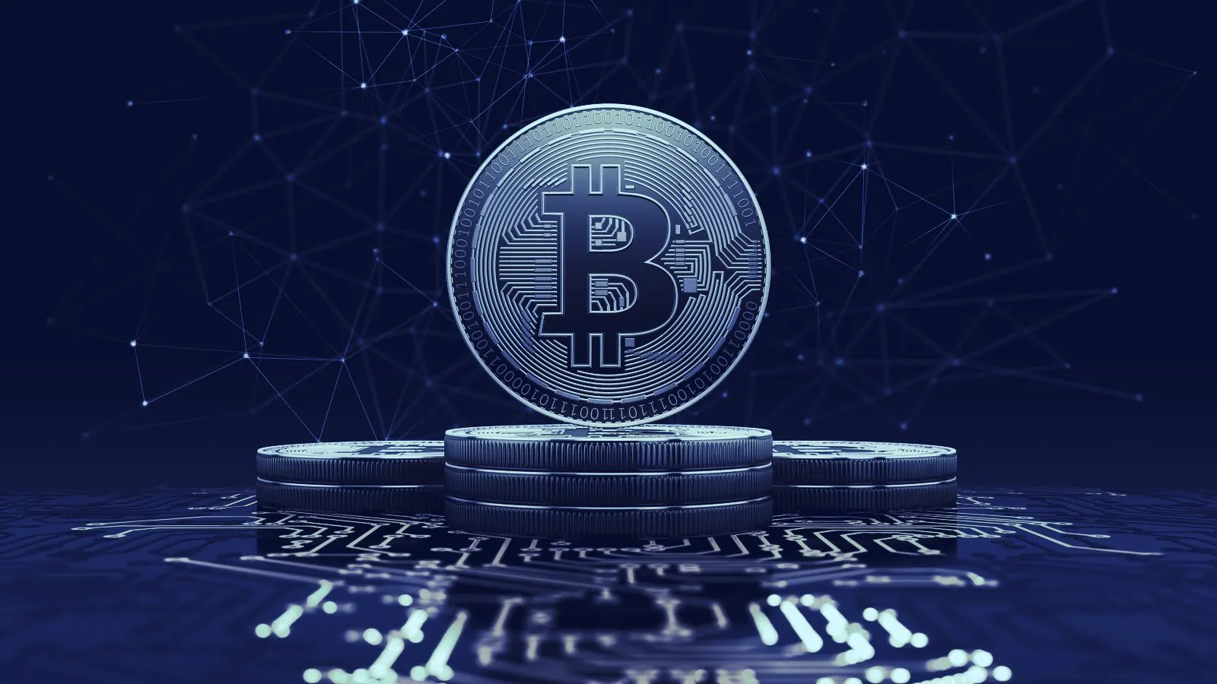
The first practical implementation of blockchain emerged in 2009
with the launch of Bitcoin by an anonymous entity known as Satoshi Nakamoto.
Bitcoin utilized a blockchain to serve as a public ledger for all transactions within its
network,
effectively solving the double-spending problem without the need for a trusted central authority.
This innovation laid the groundwork for subsequent applications and
adaptations of blockchain technology across various sectors.

Slide 11
